Slide 1
MA932: Study Groups
Space Weather
Internal Supervisor: Sandra Chapman
External Partners: Rutherford Appleton Lab,
NASA JPL

Slide 2
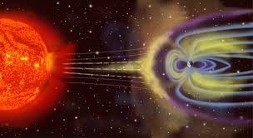
Context
The Earth has a magnetic field which can be interfered with due to varying outputs from the Sun.
Space weather can affect life on Earth with auroras and power outages.
Quebec, 1989 event left the city without power for 9 hours.
Notes:
Our group project is based around space weather with an aim to aid in a prediction based model for space weather events. Space Weather events occur as a result of random outputs of plasma and solar flares which disturb the magnetic field of the Earth. This can result in auroras and power outages such as in the 1989 geostorm which left the city of Quebec in Canada without power for 9 hours. The aim of our project is to try and identify precursors to such events and create a predictive model for them.

Slide 3
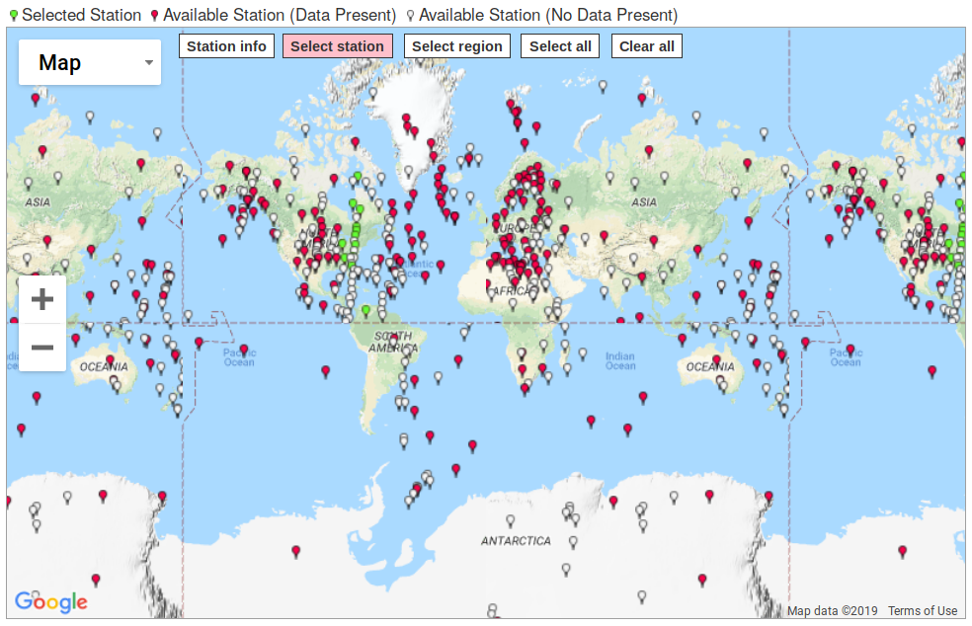
What data are we using?

Slide 4
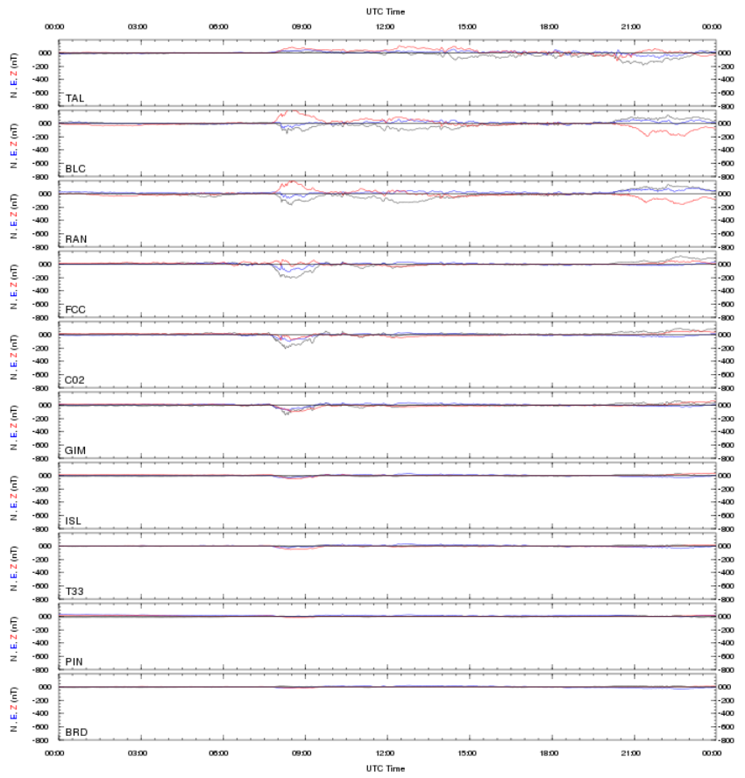
What does
this look
like?

Slide 5
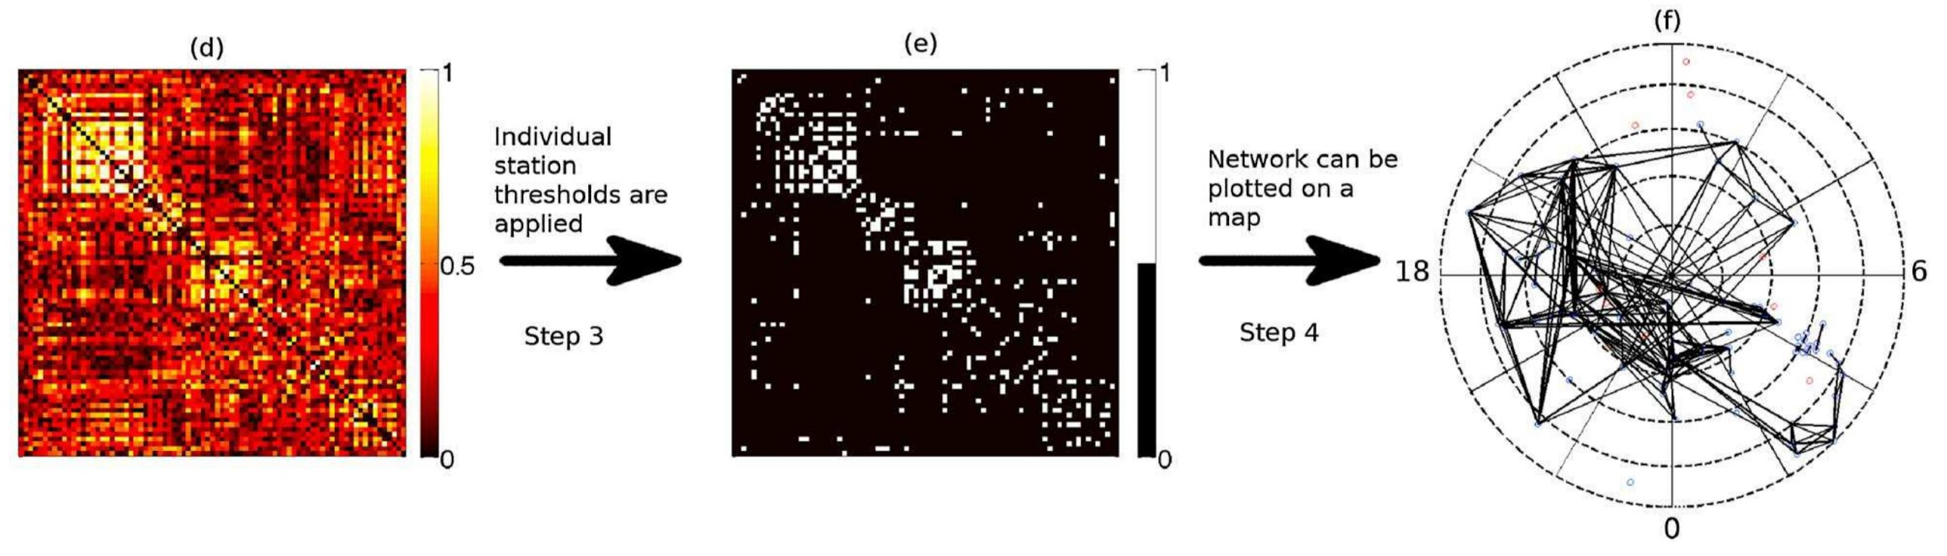
Creating the Dynamic Network Model
Vertices are the magnetometers
Edges are dynamic and undirected
Calculate cross correlation between vertices
CC above a defined threshold creates an edge
Threshold is also dynamic
Graph constantly updates with new data
Dods, et al. 2015

Slide 6
What are the potential complications?
Sheer amount of data
Geography
Earth’s magnetic field
Do wiggles cause disturbances in the force?
Notes:
Amount of data
Minute data - changes every minute so cross-correlation/matrix (and graph/network) updates every minute, and that’s without taking into account of the fact that...
Cross-correlation can be done with different time lag - right now (probably?) only 0 lag has been looked at. One of the things we can potentially look at in this project and it might make temporal correlations clearer
One way to do it is to take a station and graph it with all other stations that show “sufficient” correlation, but a reasonable cutoff point must be somehow derived
Need to take into account the distance between nodes as there are real spatial implications
Depending on the state of the earth’s magnetic field (how much energy is currently stored in it, etc), the same amount of solar activity might have different implications for things that are affected.
Kinda like earthquakes
Want to know if can predict substorms

